Slide 1
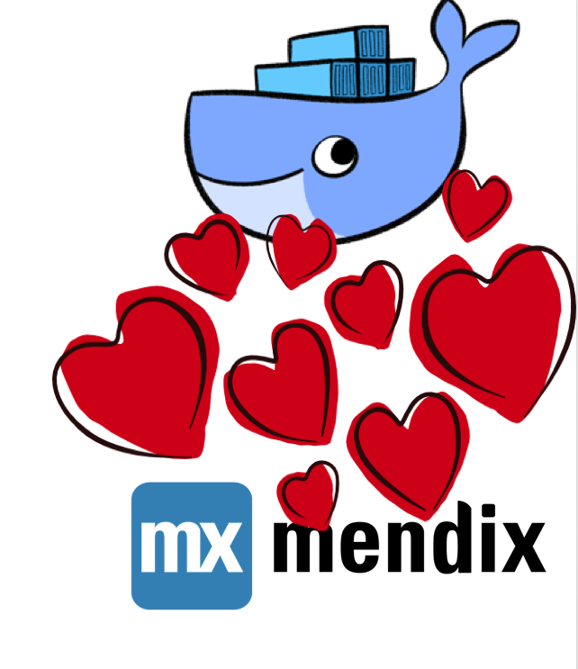
Docker and Mendix:
A Love Story
freek.brinkhuis@timeseries.nl
jim.leitch@oelan.nl

Slide 2

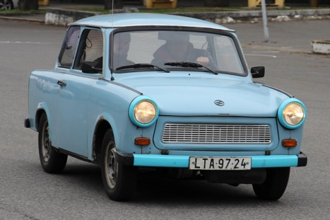


BUT WHO ARE THESE GUYS ANYWAY ????
Freekie
Communist-Era Two Stroke cars
Toy Story
Beer Tasting
Cool Stuff With Computers
Jimbo
Family Man
Dog Lover
Beer Tasting
Cool Stuff With Computers

Slide 3
Agenda:

Slide 4
Agenda:
Our Mission @ Twill Logistics (f)
Mendix & Containers – Why ? (f)
Containers & Orchestration?? (j)
Of Devops, Pipelines and SelfService (j)
W00t! Live Demo !! (f+j)
Sales Pitch (f+j)
Questions

Slide 5
Our Mission @ Twill Logistics

Slide 6
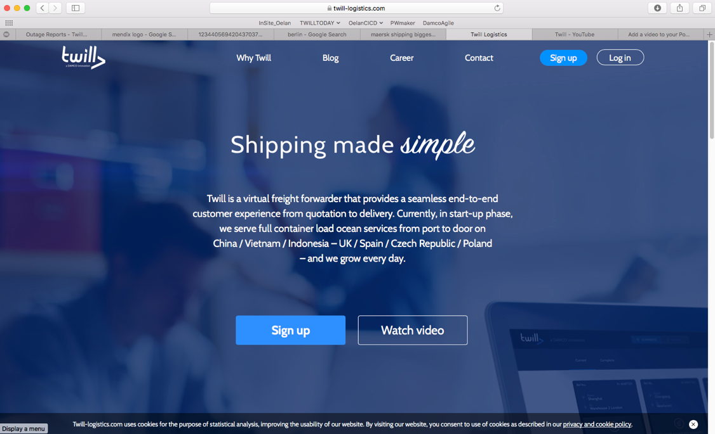
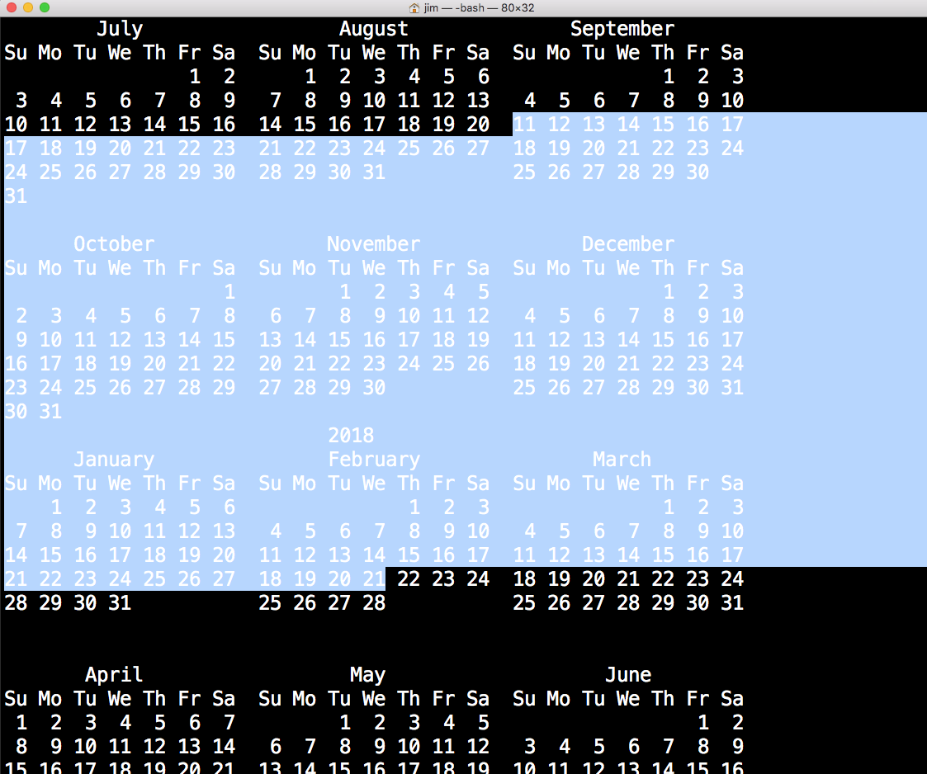
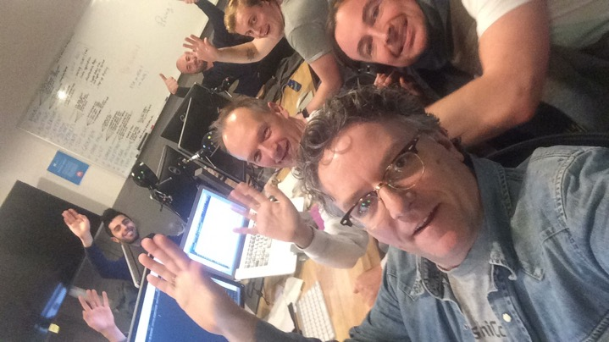

Slide 7
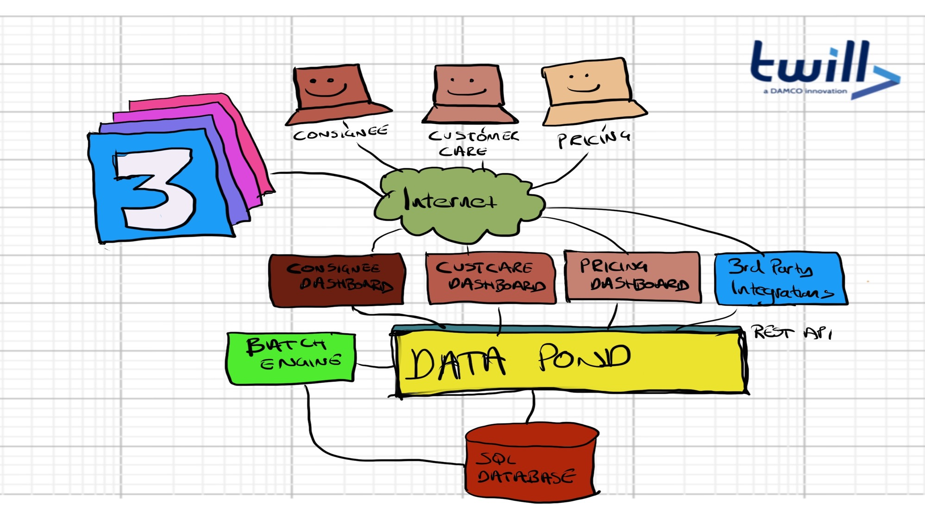

Slide 8
Requirements fitted on one A4
MVP - Style
Started With Mendix Development
Java devs brought in after 8 weeks
Ops guys after 9 weeks
Dev environment ready in 12 weeks
Production in 16 weeks
First Customer served in 20 weeks

Slide 10
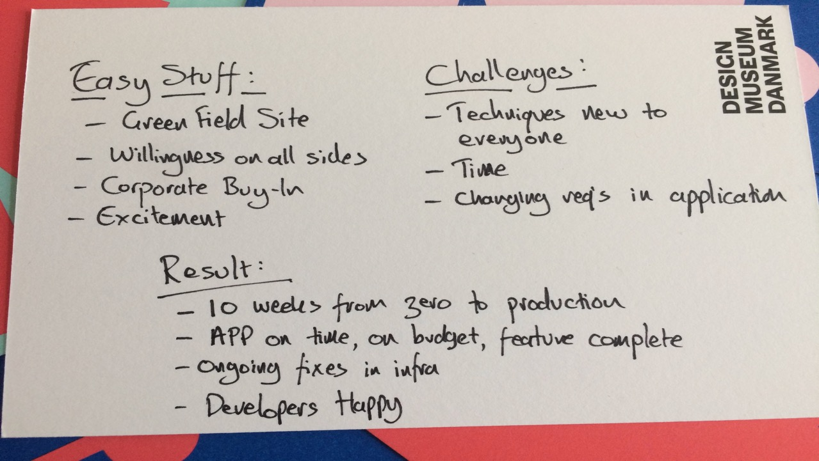

Slide 11
Why Mendix and Containers ??

Slide 12
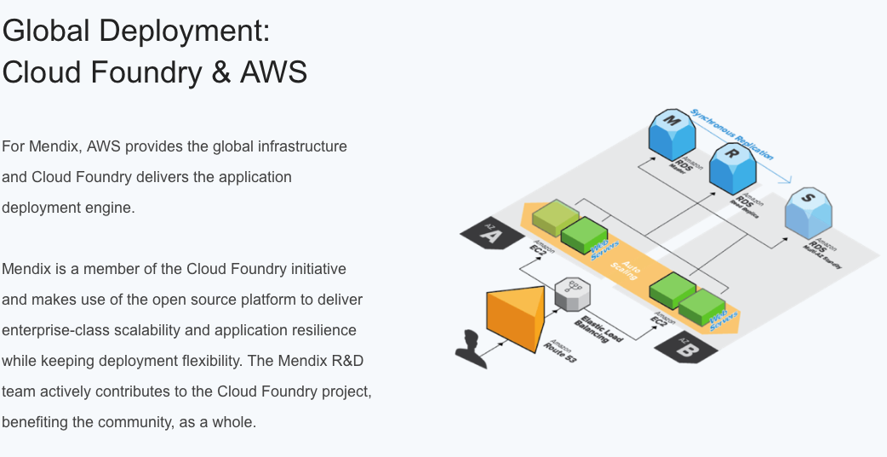

Slide 13

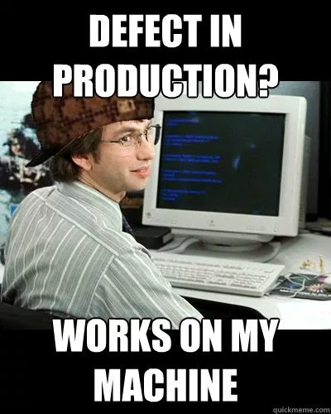

Any advantages?

Slide 14

But but, what in it for me??
Automagically deploy and test your code in one commit
Every dev has its own TEST env with all apps
Notes:
3. Whats in it for me as a developer-- Commit, build and deploy all in one go-- No more works on my machine. Your docker setup runs on all types of environments

Slide 15
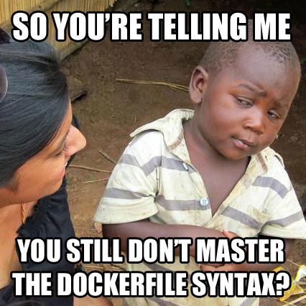
Sure, whatever can’t be that good right?
Need to learn a new platform/language (Or have a Jim as a colleague)
Environment configuration is now code, not UI
Never be able to use the Works on my machine excuse
Notes:
4. Any downsides?-- Need to have knowledge on the platform (or a Jim as a colleague)-- Configuration of your environment variables is now in code, not in UI-- No more works on my machine excuses...

Slide 16
Containers & Orchestration

Slide 17
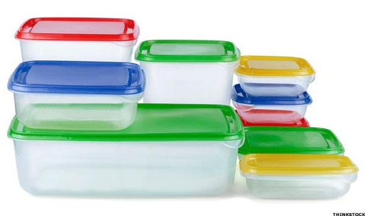
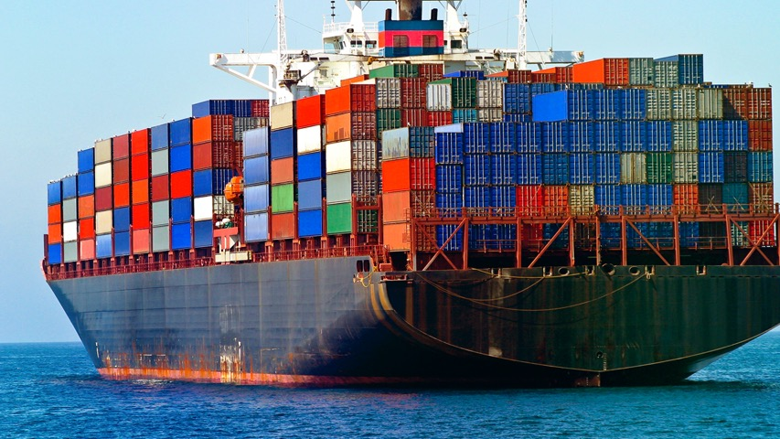
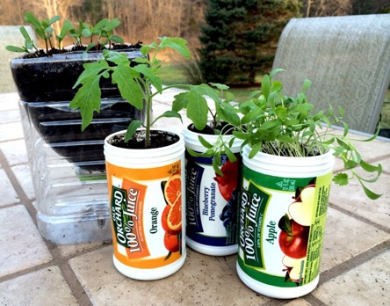

Slide 19
BORING!!!!!!!!!
Fast and portable software delivery
Err…that‘s it !!

Slide 21
Gets Difficult
Deployment
Keeping track of ports
Storage
Load Balancing
Logging
Microservices
Help, I don’t want to deal with this stuff

Slide 22
Container Orchestration
-DCOS
-Kubernetes
-Docker Swarm
-OpenShift
-Cloud Foundry

Slide 23
Of Devops and Pipelines and SelfService

Slide 25
What is / Why DevOps ?
Faster Time To Market
Smaller Releases More Often / Less Risk
“If it it hurts do it more often”
Collaboration Dev/Ops
Devs do Ops tasks, Ops use dev tools
Continuous Improvement

Slide 26
Software Deliver Pipeline

Slide 27
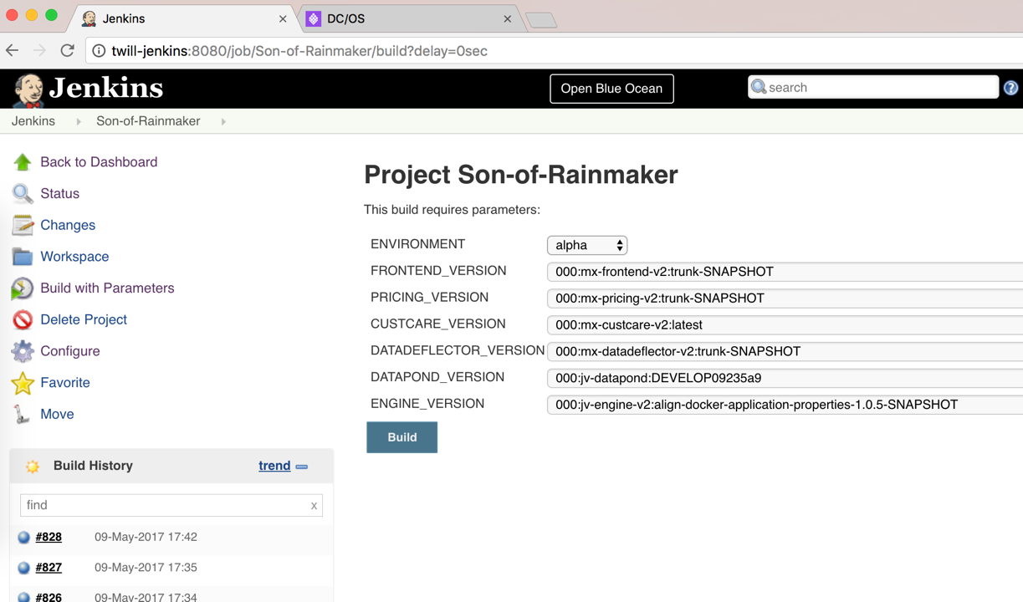

Slide 28
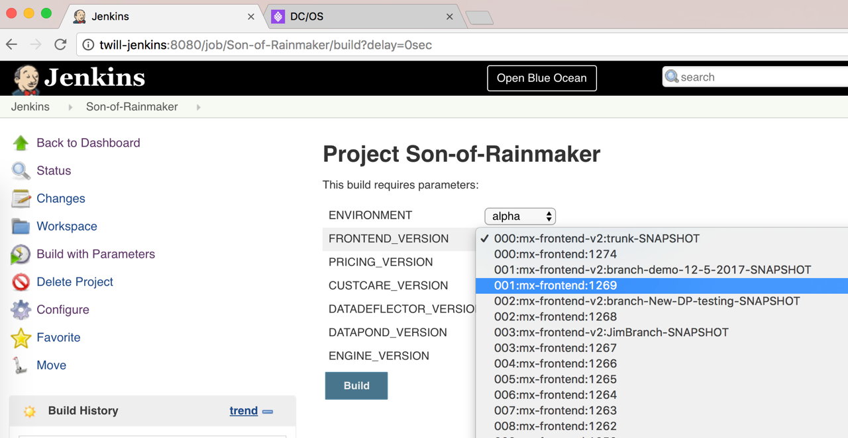

Slide 29
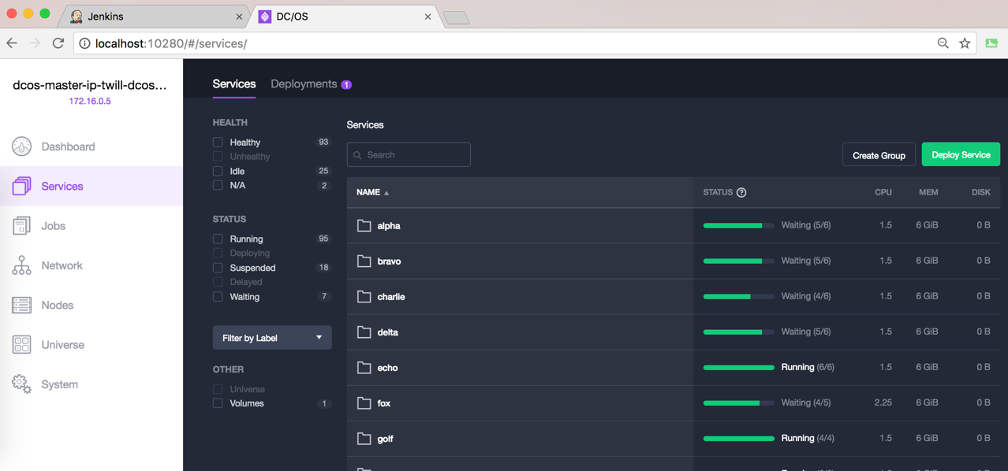

Slide 30
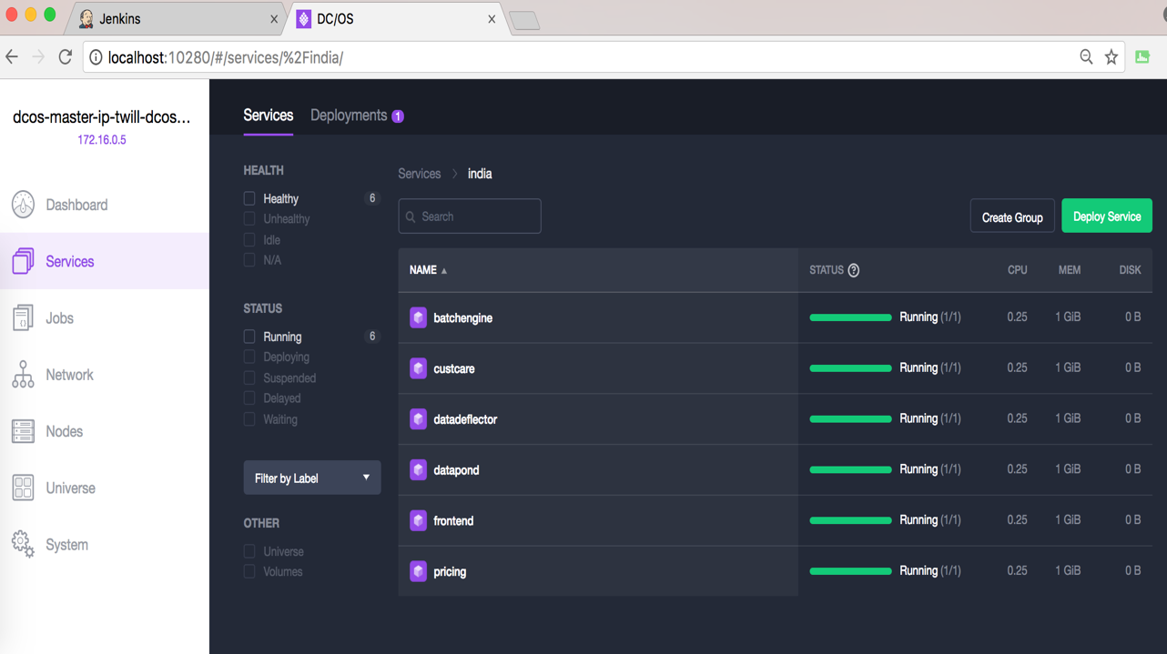

Slide 31
W00t! Demo!

Slide 32
Sales Pitch:

Slide 33
We Help You Setup Software Delivery Pipelines (Especially Mendix Ones)
Cloud Operations (Mendix too)
Automated testing (Yep)
App development (not mendix yet)
Data Privacy
Blah
Blah
Blah
Blah
Blah

Slide 34
Reading List
The Phoenix Project
Release IT
The DevOps Handbook
Continuous Delivery (& Spotify diagrams)
Google Site Reliability Engineering
Gödel, Escher, Bach: An Eternal Golden Braid

